Slide 1
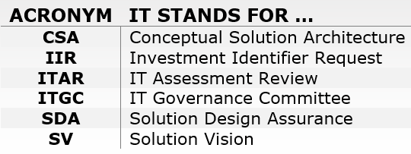
Gate A US Pre-Startup Process (infographic format) - DRAFT
Gate A
CIO’s Domain Architect
Business Consultant
Run/Upgrade/Enhancement
No CSA, no arch review
Business Consultant
ITAR Form
The new ITAR form consists of 8 impact questions.
There are 3 possible ITAR assessment outcomes.
IIR
Create IIR to generate an
INVIP #
Then …
Submit for ITAR
Create Gate A Submission Form for CIO and BP Approval
Done
Value Step/Grow/Strategic
CSA or CSA lite, review by SDA board
Business Consultant
Create Value Case
One Page only
CIO Approval required
Transform
Solution Vision, review by ITGC (rare)
Note: Revisit 8 – 12 weeks after Sanctioning with Business Case details.
CIO Exemption Process

Slide 2
Gate A UK Pre-Startup Process (infographic format) - DRAFT
Gate A
CIO’s Domain Architect
Run/Upgrade/Enhancement
No CSA, no arch review
Business Consultant
Business Consultant
ITAR Form
The new ITAR form consists of 8 impact questions.
There are 3 possible ITAR assessment outcomes.
IIR
Create IIR to generate an
INVIP #
Then …
Submit for ITAR
Create Gate A Focal Point Gate A Submission Record for EPMO Approval
Done
Value Step/Grow/Strategic
CSA or CSA lite, review by SDA board
Transform
Solution Vision, review by ITGC (rare)

